Slide 1

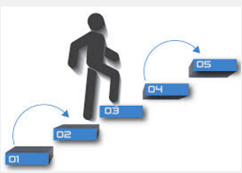

DS 21®
Business Decision Support Software For The 21st Century
100% web-based, no installation or setup
Cost effective, true Cloud SAAS app, pay only for what you use, access anywhere, any time.
Simple, clear, guided step-by-step operation
Can be utilized by one person or a large team
Based on proven, business-tested statistical science

Slide 2



Use DS 21® To Make Important
Business Decisions Like
Budget allocation
Portfolio selection
Prioritize projects
Selecting a venture capital portfolio
Sales strategy
R & D and innovation choices
Product or vendor selection
Build vs. buy
Move vs. stay
Rank tens of ideas and new products
Hiring decisions
… Or any other choice or decision!

Slide 3
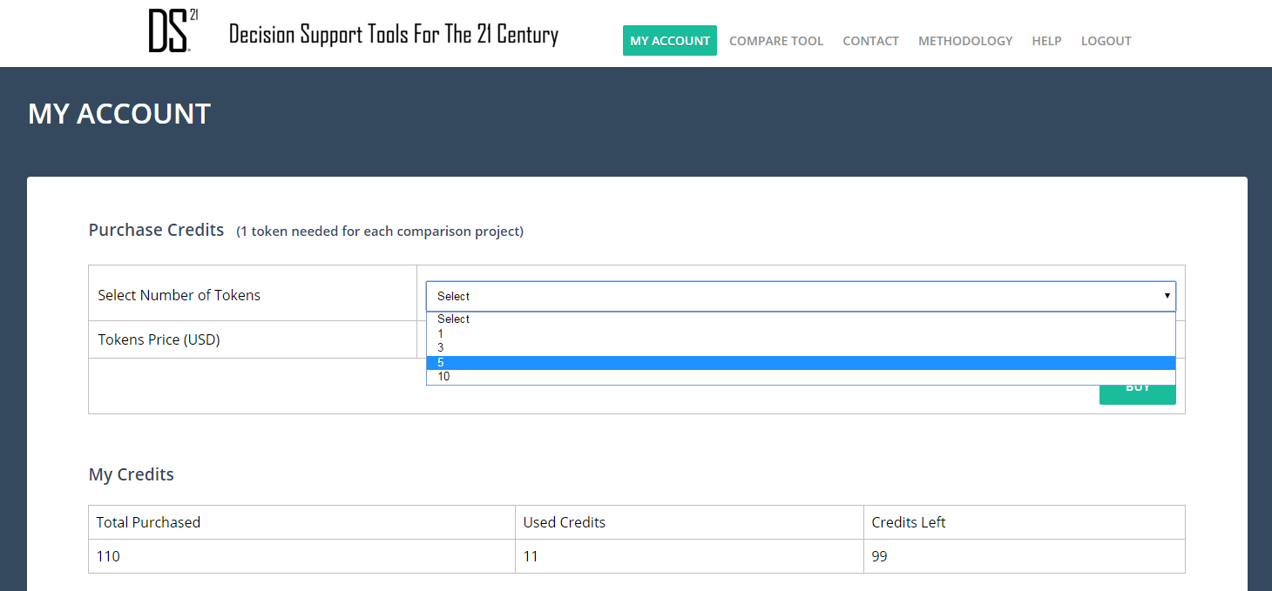
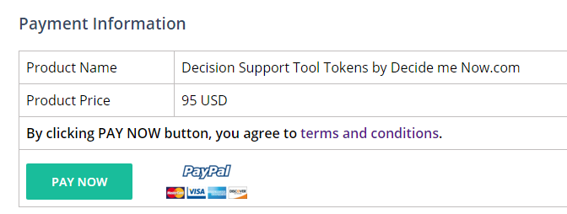
To use DS 21®
You need to purchase tokens.
Each comparison session costs 1 token.
To purchase tokens go to “MY ACCOUNT”.
Select as many tokens as you need.

Slide 4
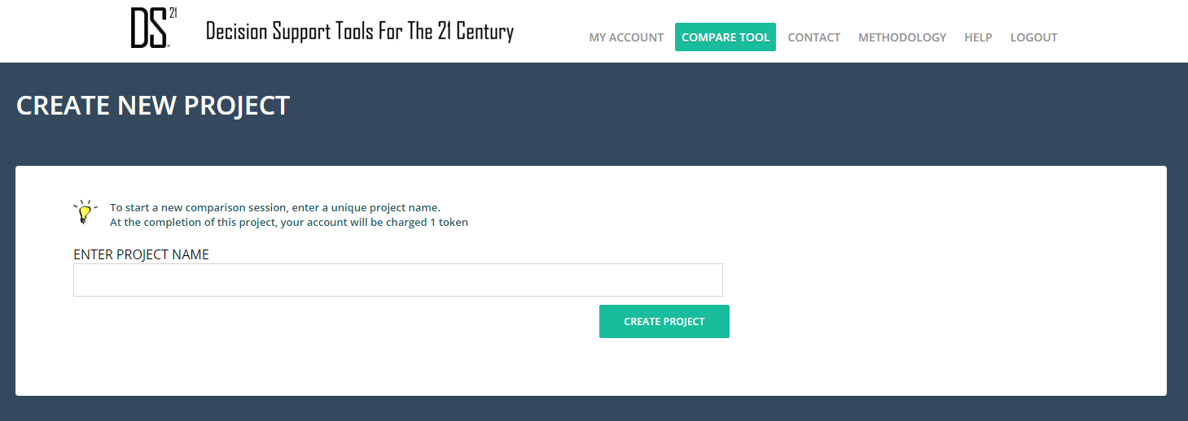
Now You Are Ready
To Start a Comparison & Ranking Session
STEP 1:
Click on the ‘COMPARE TOOL’ tab
Enter a project name and
Click on “CREATE PROJECT”

Slide 5
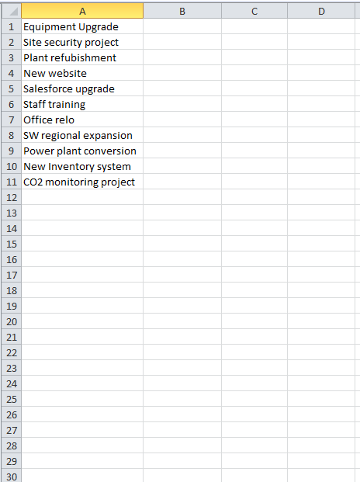
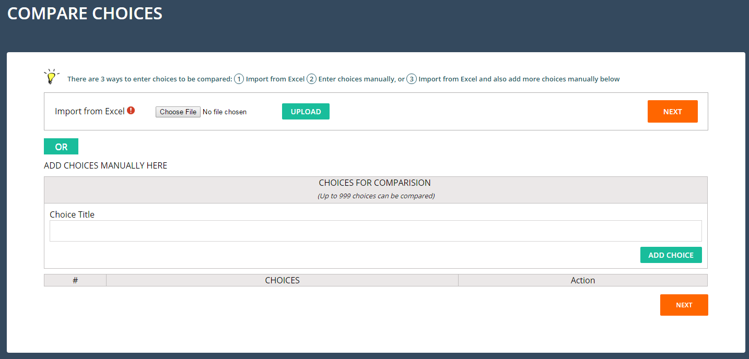
STEP 2:
Enter choices to be compared. These choices can be:
Manually typed-in,
Imported from a single-column Excel spreadsheet,
Or you can use both methods together.
Single Column Excel Spreadsheet
Once you UPLOAD the file, Click NEXT

Slide 6
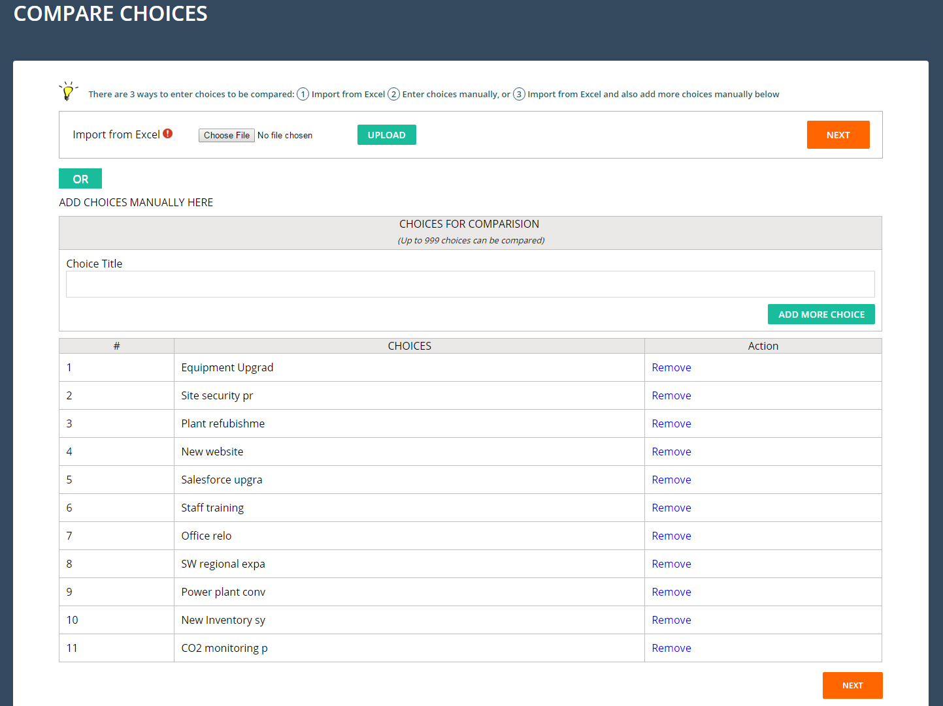
If you uploaded choices from Excel, you can also add more choices manually here
… And you can remove any unwanted choices here
Once you are done with loading all the choices, click NEXT

Slide 7
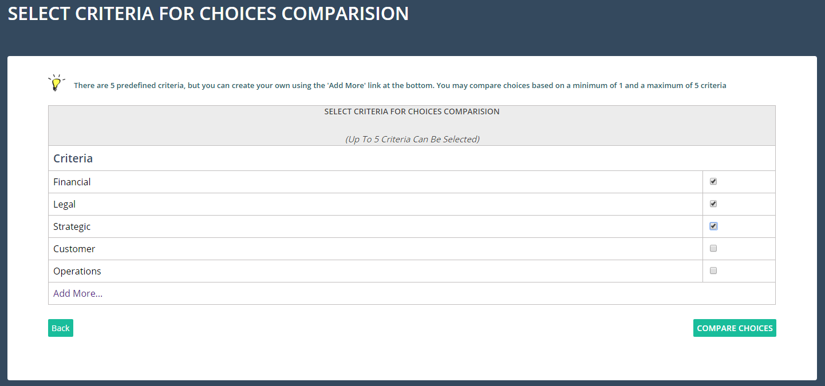
STEP 3:
Now you need to select the criteria upon which the comparison & Ranking will be conducted. Up to 5 criteria are allowed. For your convenience, there are 5 pre-defined criteria, but you can define your own (but the maximum will still be 5). In the example below, only 3 criteria were selected as the basis for comparison.
Once you are done with criterial selection, click “COMPARE CHOICES”
You can add and define your own criteria here
Once you are done
with criterial selection

Slide 8
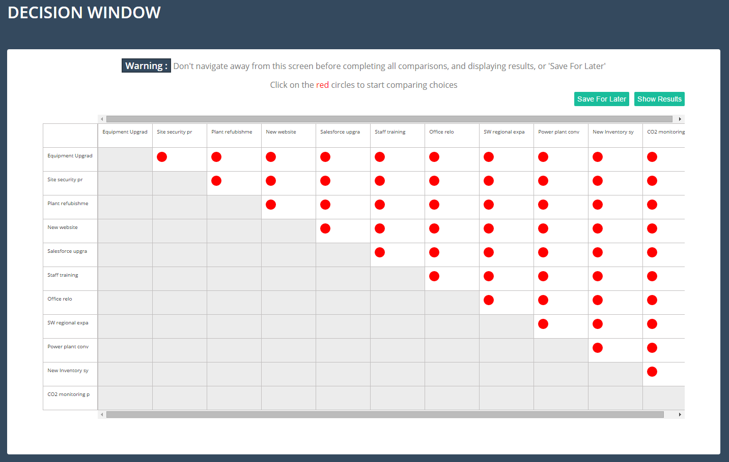
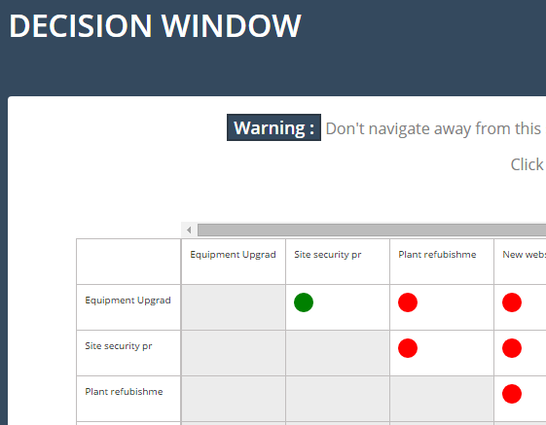
STEP 4:
The DECISION WINDOW is where you start using the DS 21 algorithm to Rank & Prioritize choices, projects, ideas, budget items, etc.
These red dots represent a ‘Point of Comparison’ between two choices. You must compare ALL pairs of choices before the results can be shown. If unable to finish all comparisons, you can save the session for a later time
Once you have finished comparing choices in any given RED DOT, it will automatically turn GREEN

Slide 9
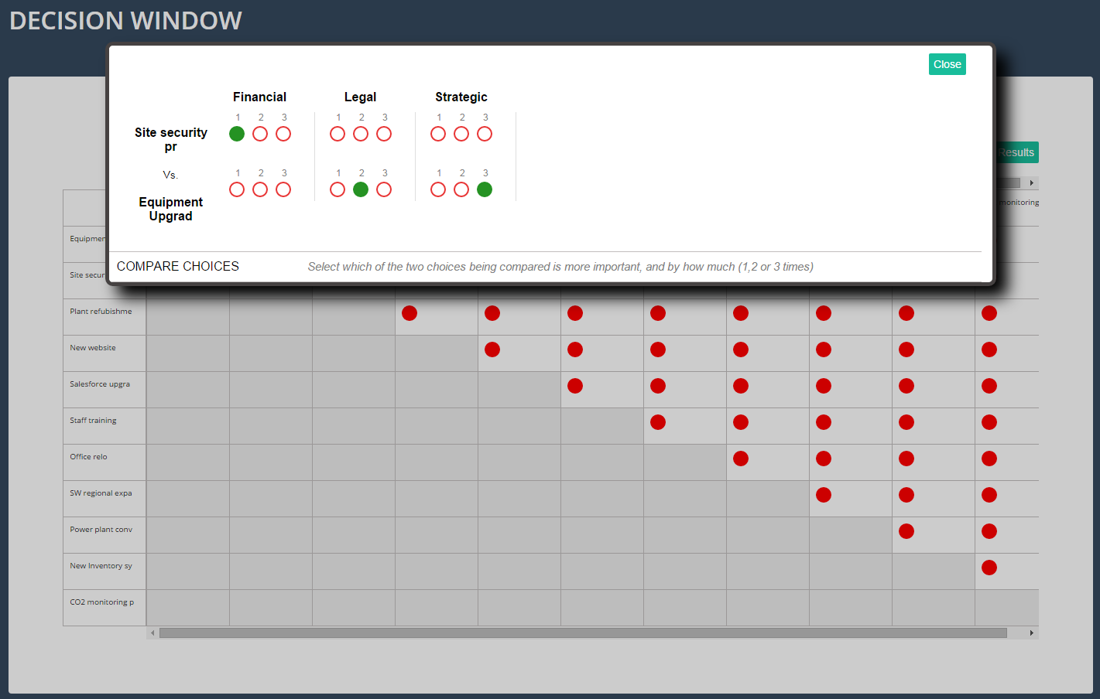
STEP 5:
Click on the ‘RED DOTS’ to start comparing choices. This screen shows a comparison between 2 choices based on 3 criteria. In this example; Financial criteria, ‘Site Security’ is more important than ‘Equipment Upgrade’ by a factor of 1 degree, whereas when using the Legal Criteria, ‘Equipment Upgrade’ is more important than ‘Site Security’ by a factor of 2. You must finish all comparisons before you can display the results
If you are comparing a large number of choices, you will need to scroll to see all ‘RED DOTS’

Slide 10
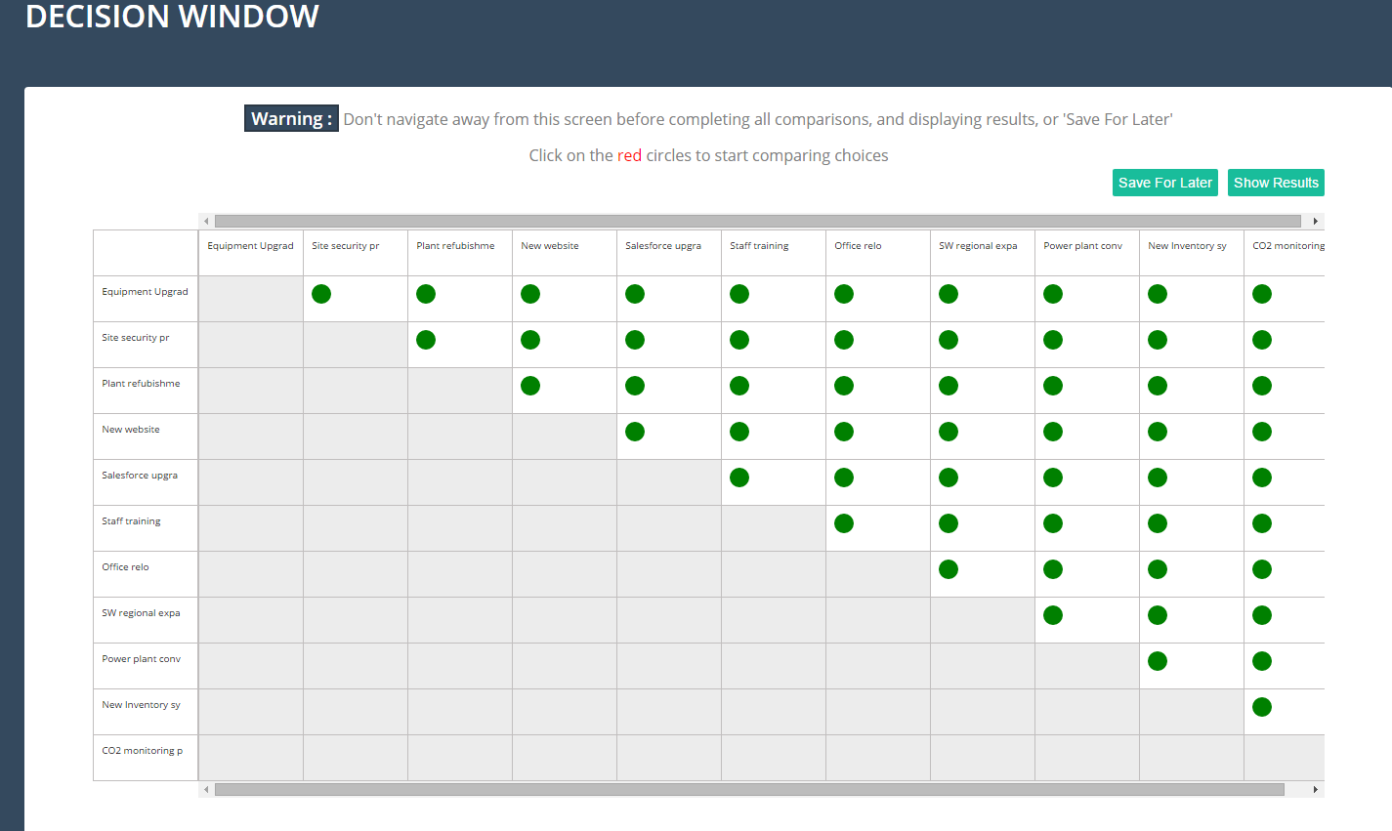
STEP 6:
Once all comparisons are done, you can either ‘Save For Later’, or click on ‘Show Results’ to display ranking report.
Don’t navigate away from the ‘DECISION WINDOW’ screen before completing all comparisons, or saving the worktable for later. Work will be lost, otherwise
Completed Decision Session
All dots are green

Slide 11
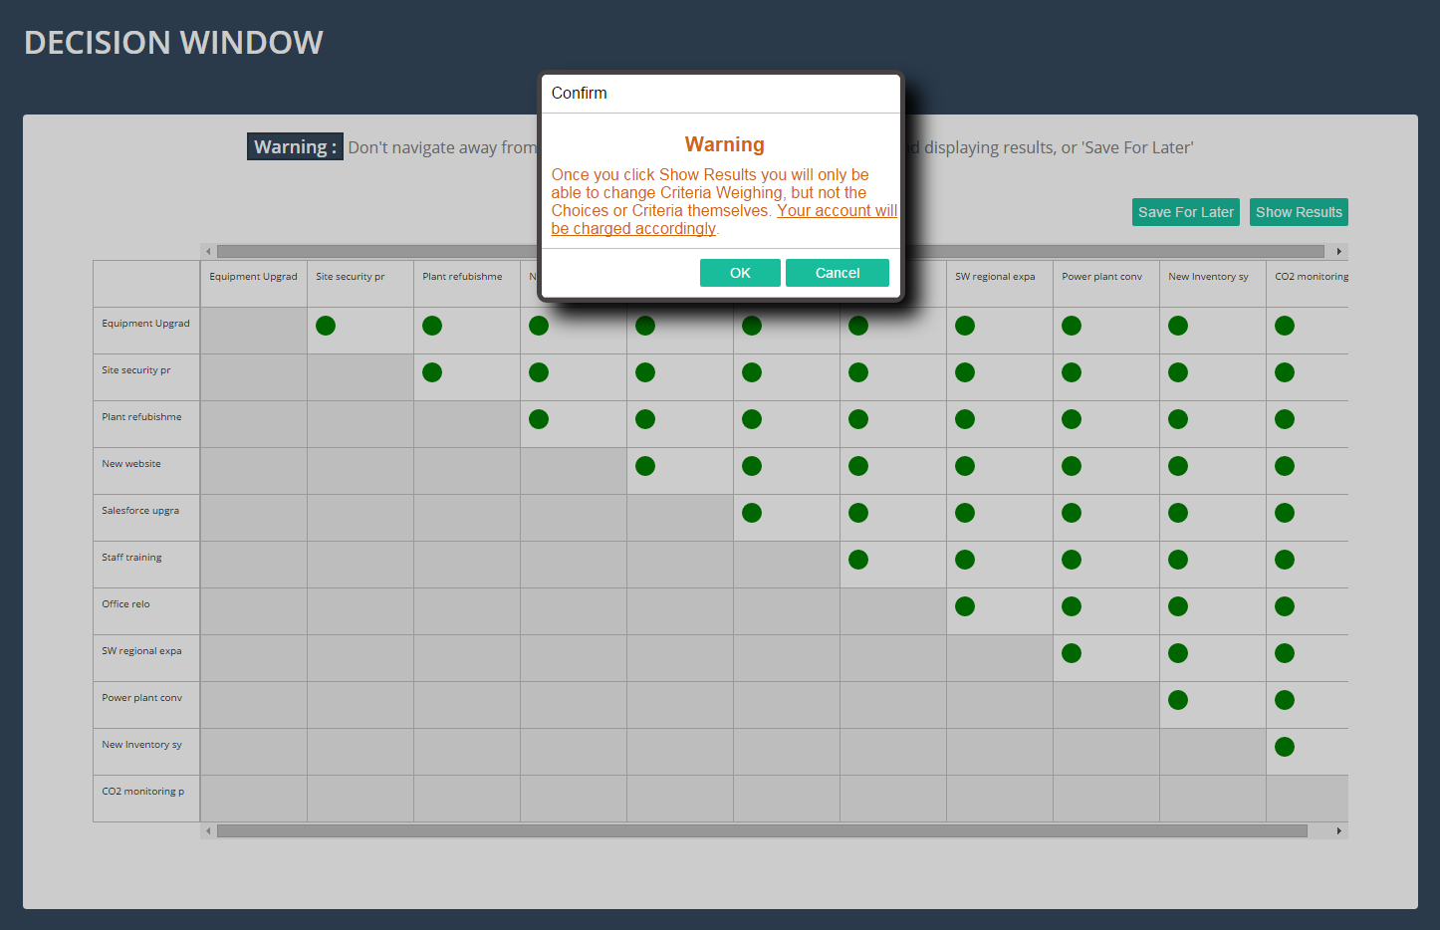
Once you click on Show Results, you will be prompted with a warning stating that if you click ‘OK’, your account will be charged 1 token.
If you save the project, you may re-open it later. Only the criteria weighing can be changed, but not the choices or the criteria themselves.

Slide 12
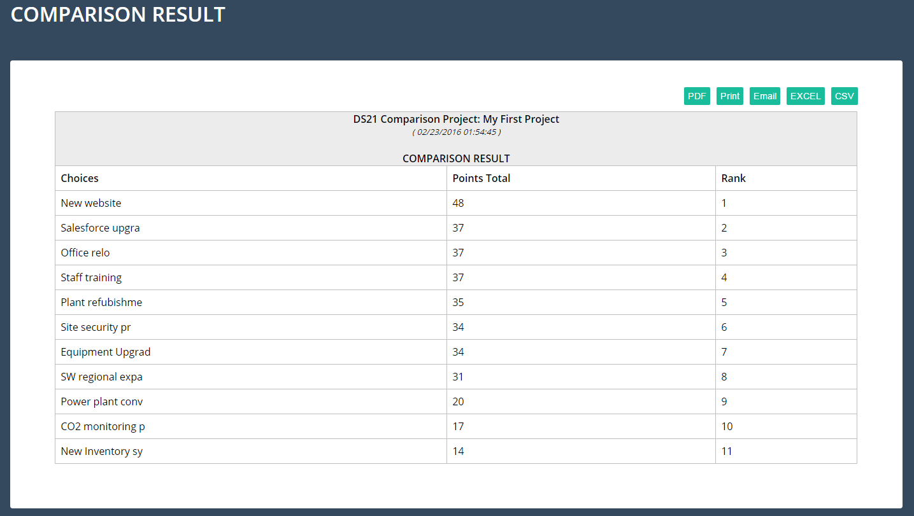
STEP 7 (final step):
Once you confirm acceptance of the token charge, by clicking ‘OK’ the comparison result will be displayed, showing the ranking of choices and their point scores.
You can also PRINT the report, save as PDF, email the result to yourself, or export to Excel or as a CSV

